Slide 1

UNIVERSITY INSTITUTE OF COMPUTING
MASTER OF COMPUTER APPLICATIONS
DESIGN AND ANALYSIS OF ALGORITHMS
UNIT-3
DISCOVER . LEARN . EMPOWER

Slide 2
P,NP,NP Hard, NP Complete
In most cases we use an “Easy-to-Hard” scale to classify problems.
In theoretical computer science, the classification and complexity of common problem definitions have two major sets;
P which is “Polynomial” time.
And NP which “Non-deterministic Polynomial” time.
There are also NP-Hard and NP-Complete sets, which we use to express more sophisticated problems.
In the case of rating from easy to hard, we might label these as “easy”, “medium”, “hard”, and finally “hardest”.

Slide 3
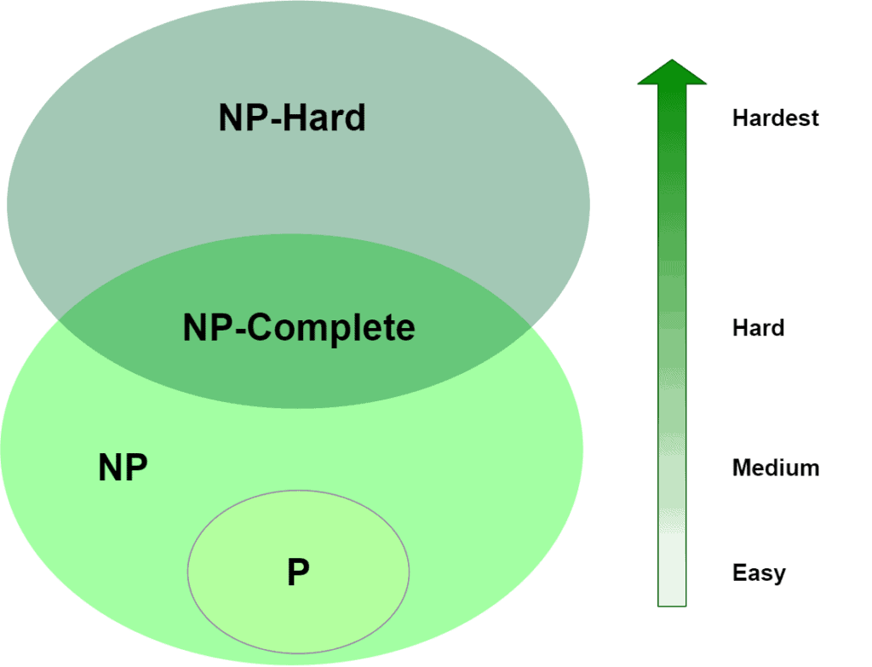
P,NP,NP Hard, NP Complete
Easy-- P
Medium-- NP
Hard-- NP-Complete
Hardest-- NP-Hard
We’ve mapped P, NP, NP-Complete and NP-Hard to “easy”, “medium”, “hard” and “hardest”, but how does we place a given algorithm in each category?

Slide 4
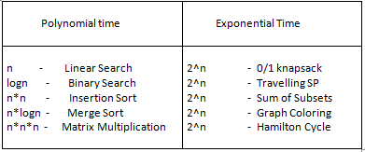
P,NP,NP Hard, NP Complete
Algorithms can be classified in two forms:
Polynomial Time
Exponential Time

Slide 5
P (Polynomial) Problems
P problems refer to problems where an algorithm would take a polynomial amount of time to solve, or where Big-O is a polynomial (i.e. O(1), O(n), O(n²), O(log n) etc). These are problems that would be considered ‘easy’ to solve, and thus do not generally have immense run times.
For Example: Linear Search, Binary Search, Insertion Sort etc.
Polynomial Problems can be solved and verified in polynomial time.

Slide 6
Deterministic & Non-Deterministic
Deterministic algorithms: where we know working of each and every step.
Non-Deterministic algorithms: where we know the working of maximum steps and that can be solved in deterministic time, but few statement may be non-deterministic. Future research work can be performed on that block in the code to make it deterministic.

Slide 7
NP (Non-deterministic Polynomial) Problems
A problem that cannot be solved in polynomial time but can be verified in polynomial time using Non-deterministic algorithms is known as NP(Non-deterministic Polynomial) problem.
In terms of solving a NP problem, the run-time would not be polynomial. It would be something like O(n!) or something much larger.
We expect these algorithms to have an exponential complexity.
For Example: Travelling Salesman Problem, 0/1 Knapsack etc.

Slide 8
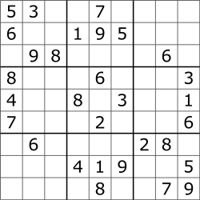
NP (Non-deterministic Polynomial) Problems
In order to solve this entire puzzle, the algorithm would have to check each 3x3 matrix to see which numbers are missing, then each row, then each column, and then make sure there are no repetitions of any digit from 0–9. This becomes more complex because the number of digits that are missing is inconsistent in each row, column, and matrix (i.e. top-left matrix is missing 4 digits while top-right matrix is missing 8 digits).
Solving this problem would not have a polynomial run-time. However, if you were to feed this puzzle with a possible solution, it would be much less complex to check if there are any repetitions in the rows, columns and matrices. This is a simple check which would have a polynomial run-time.

Slide 9
NP (Non-deterministic Polynomial) Problems
Algorithm: N Search(A, n, key)
{
J=choice();
If(key==A[J])
Write(J);
Success();
}
Write(0);
Failure();
}

Slide 10
Reduction
We have two problems, A and B, and we know problem B is a P class problem. If problem A can be reduced, or converted to problem B, and this reduction takes a polynomial amount of time, then we can say that A is also a P class problem (A is reducible to B).

Slide 11
NP-Hard Problems
The algorithm that cannot be solved in polynomial time are called NP Hard problems.
A problem is classified as NP-Hard when an algorithm for solving it can be translated to solve any NP problem. Then we can say, this problem is at least as hard as any NP problem, but it could be much harder or more complex.
Example: Sum of subsets problem

Slide 12
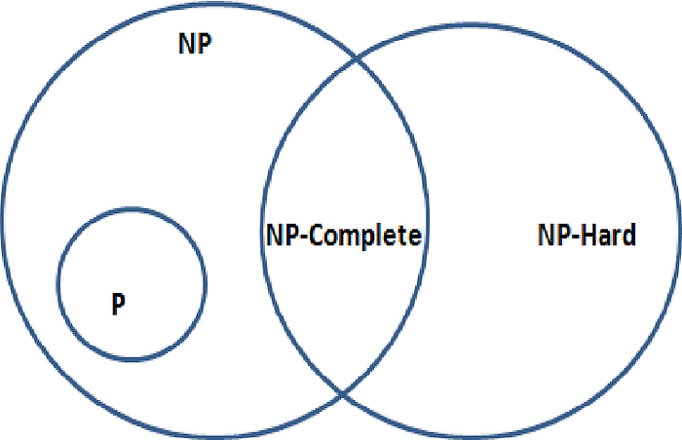
NP-Complete Problems
If a problem A can be reduced to NP problem B in polynomial time. There problem A will be called NP-Complete problem.
Example: Graph Coloring etc.
NP-Complete problems are problems that live in both the NP and NP-Hard classes. This means that NP-Complete problems can be verified in polynomial time and that any NP problem can be reduced to this problem in polynomial time.

Slide 13
Role of P and NP concept in computer Science
Theoretical Impact on Computer Science
Understanding Computational Limits:
The P vs NP problem defines the boundary between tractable and intractable problems. Solving it would clarify which problems are fundamentally hard to solve efficiently.
Implications for Problem Solving:
If P = NP, it would imply that many problems believed to be hard (e.g., SAT, Traveling Salesman, Integer Programming) actually have efficient algorithms.
Effect on Complexity Theory:
Resolving the problem would significantly advance the field of computational complexity theory, possibly leading to the reclassification of many known problems.
Consequences in Cryptography:
Modern cryptographic systems rely on the assumption that certain NP problems are not in P. If P = NP, many encryption schemes could be broken, affecting security and privacy on a global scale.
Algorithm Design and Optimization:
If P ≠ NP, it justifies the use of heuristic, approximation, or probabilistic algorithms for NP-complete problems.
If P = NP, it could lead to efficient exact algorithms for a wide range of real-world applications.

Slide 14
THANK YOU
For any Queries-
E-Mail: gurpreetkaur.uic@cumail.in

